Slide 1

Vision Based Volumetric Flow Measurement for wastewater and Storm water Networks
SeyedMojtaba Noghabaei
North Carolina State University

Slide 2
Outline
Overview
Assumptions
Model
Works to be done

Slide 3
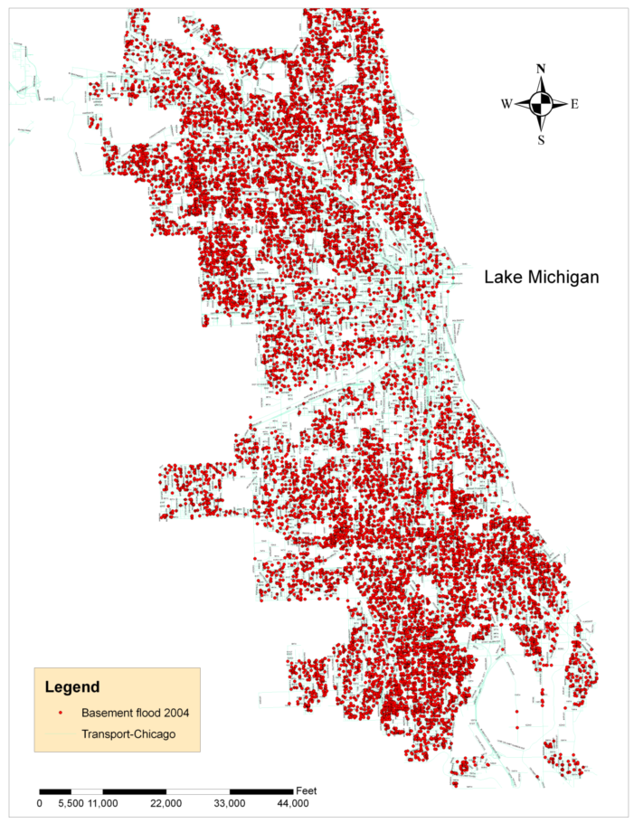
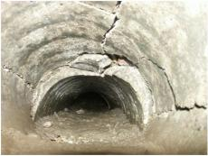
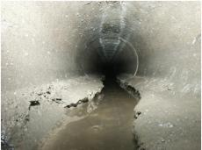
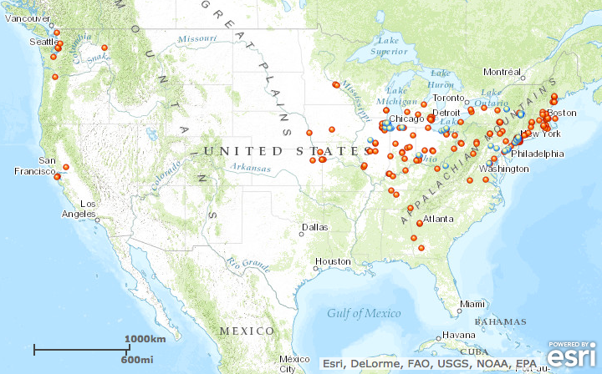
Observed Problems
Overflow in storm water network
Pipe cracks and clogging
Detecting which pipes need cleaning
Basement flooding complaints documented in Chicago during 2004

Slide 4
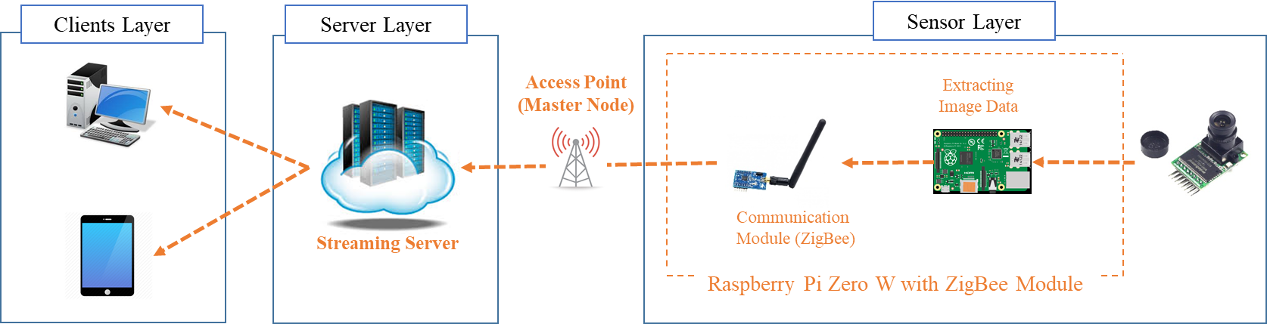
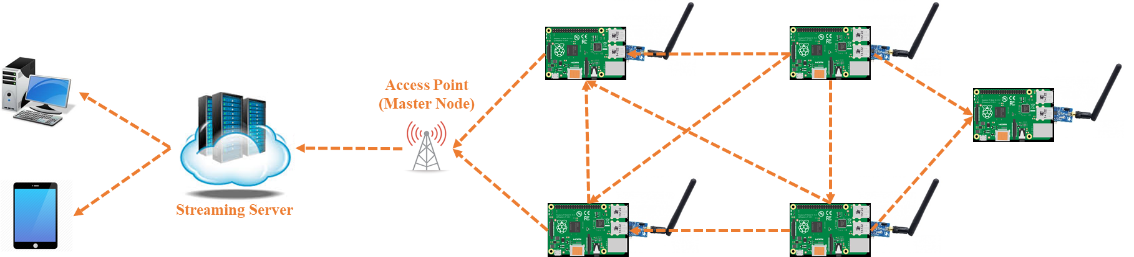
System Architecture
Notes:
Long range access
Range might be an issue !

Slide 5
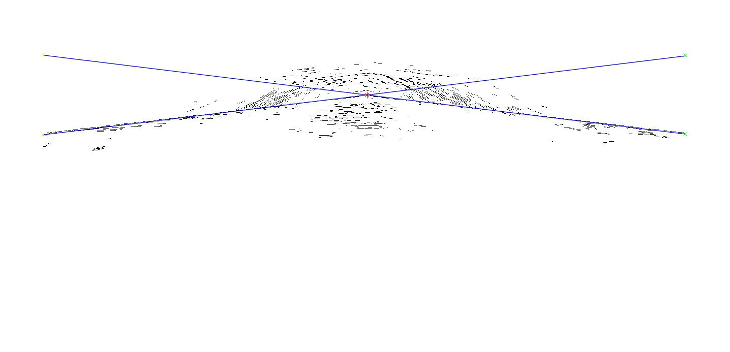
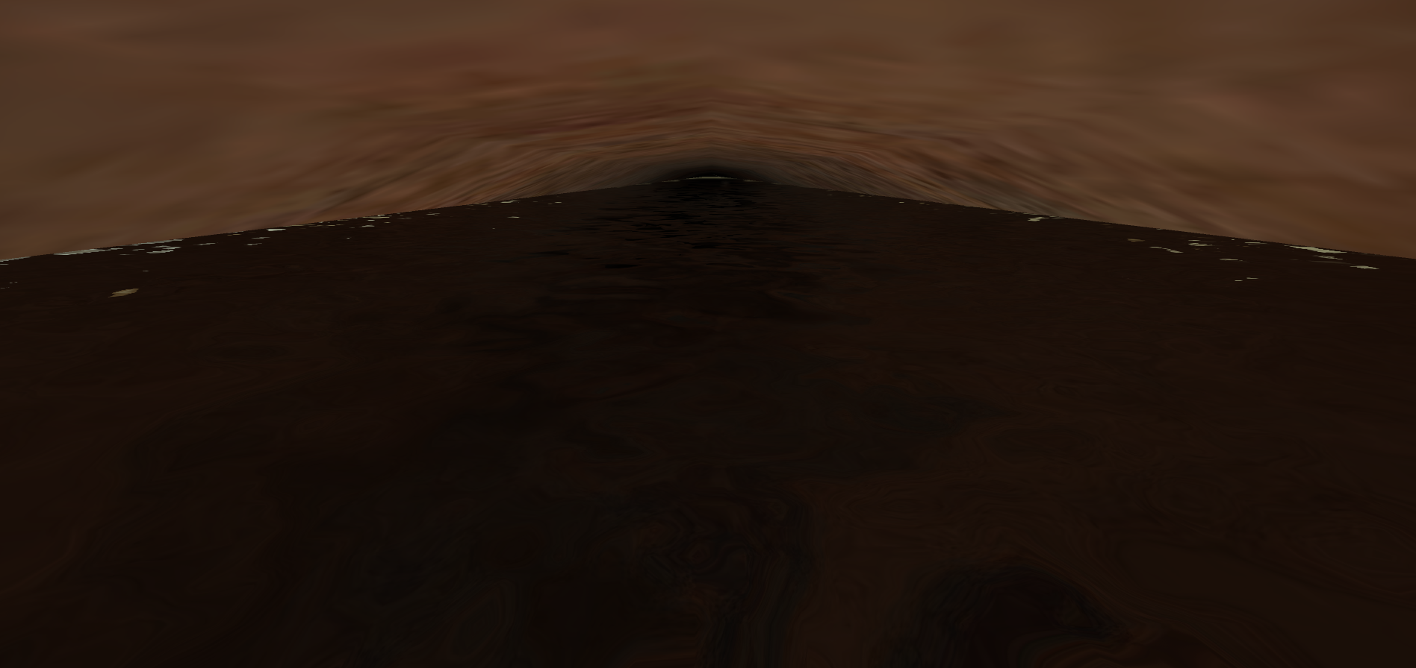
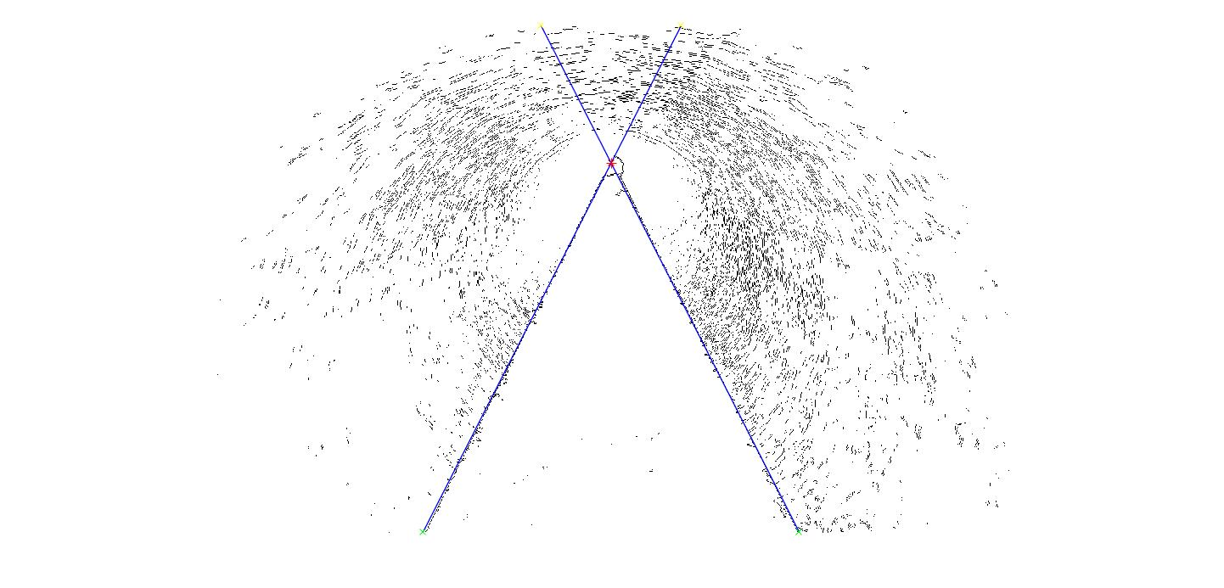
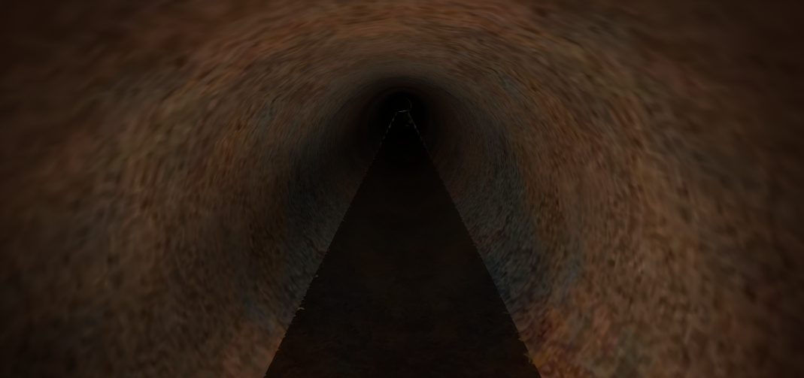
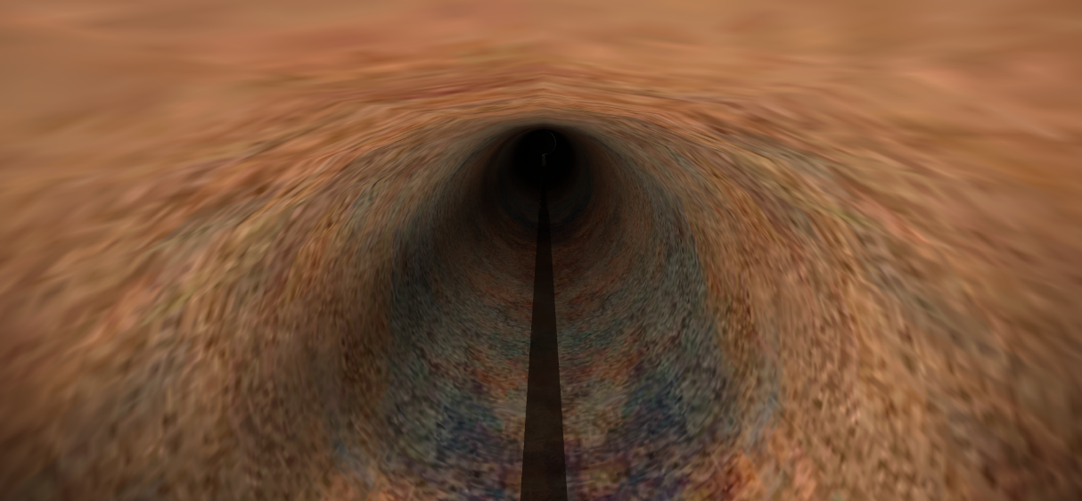
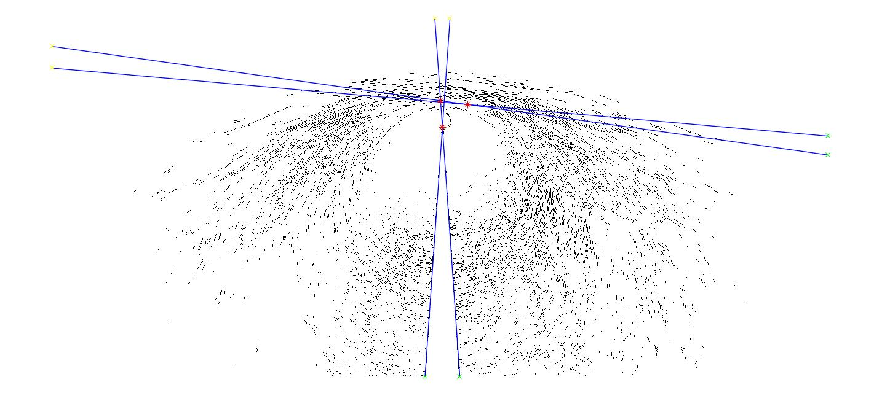
Image processing and vanishing lines
Edge Detection Filters
Notes:
Vanishing lines are perspective lines
Slope of the lines means the level of the water inside pipe

Slide 6
Assumptions
We have two sensors for each pipe
At the beginning and end
Vf at start is 2 and it is fixed
Vf at end is 1
Each key button is ten minute
Vf danger
Above 30 is blue
Above 60 is danger

Slide 7
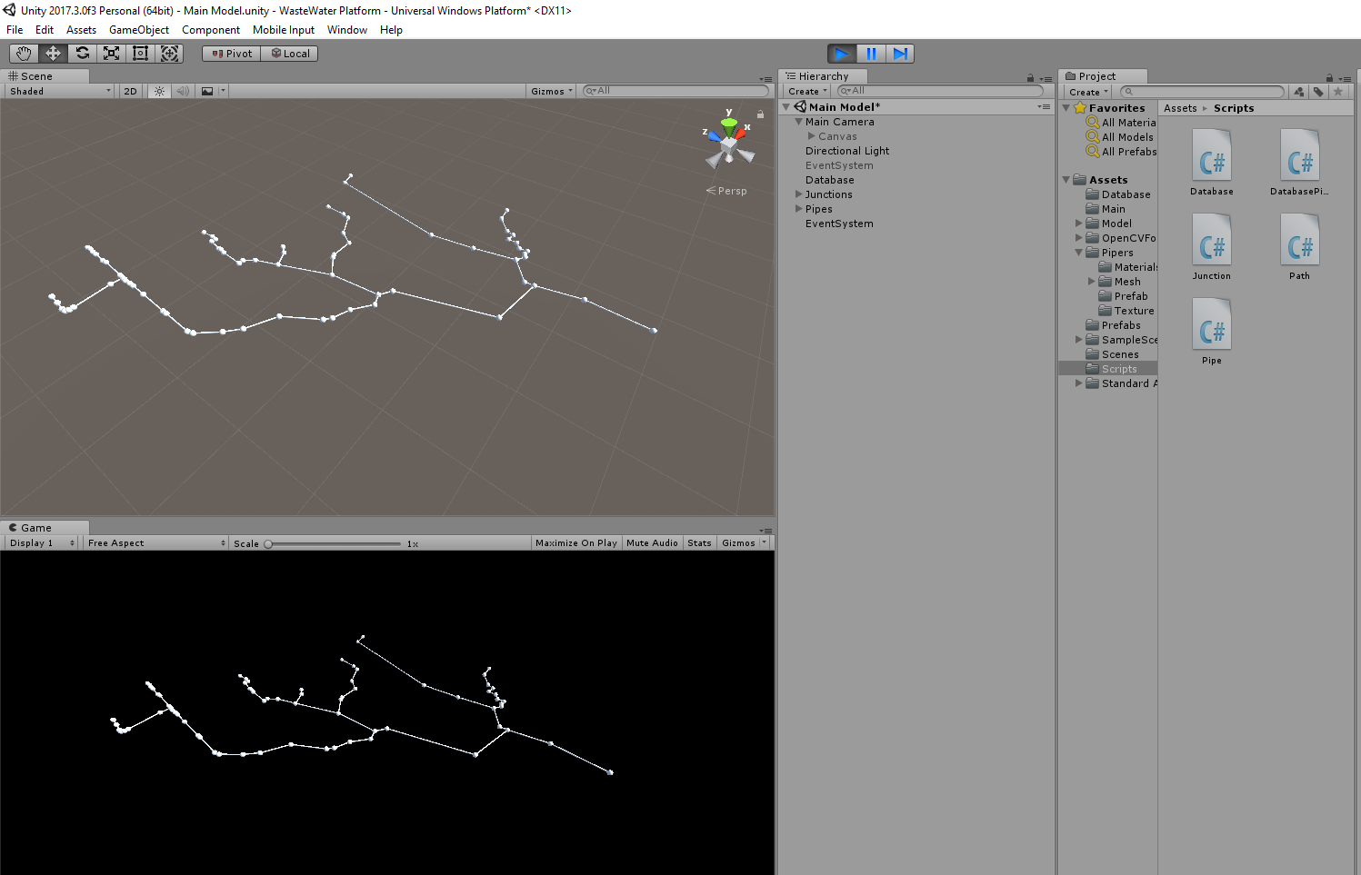
Unity Model
Water Flow Mapping and Auto Alert to Citizens

Slide 8
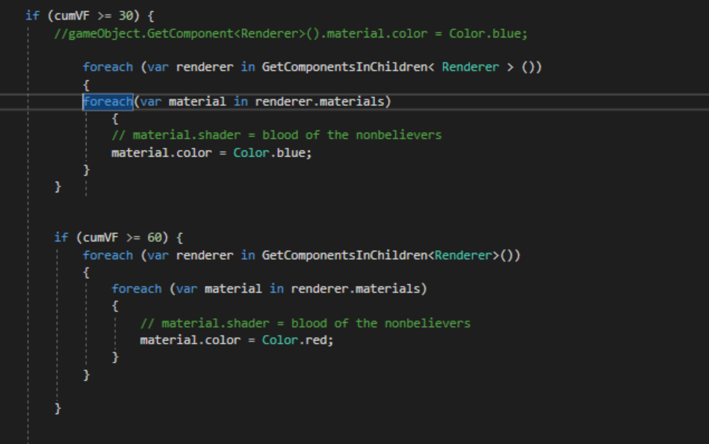
Unity Model
VF more than 30 is blue
VF more than 60 is red

Slide 9

Unity Model
Water Flow Mapping and Auto Alert to Citizens

Slide 10
Works to be done
Voice commands
Heatmap of flow
Show data in MR using voice commands
Improve analysis
Notes:
*I reserved one hololens for next week.

Slide 11
Thank You

